Slide 1


Program: MSBA 250— Applied Business Analytics
Academic Year: Spring 2024
Group Members:
Shabana Gul
Sushmith Banoth
Priya Shrotri
Eshma Cherukuri
Sirivanth Sai Bandreddi
Phuc Minh Thao Pham

Slide 2
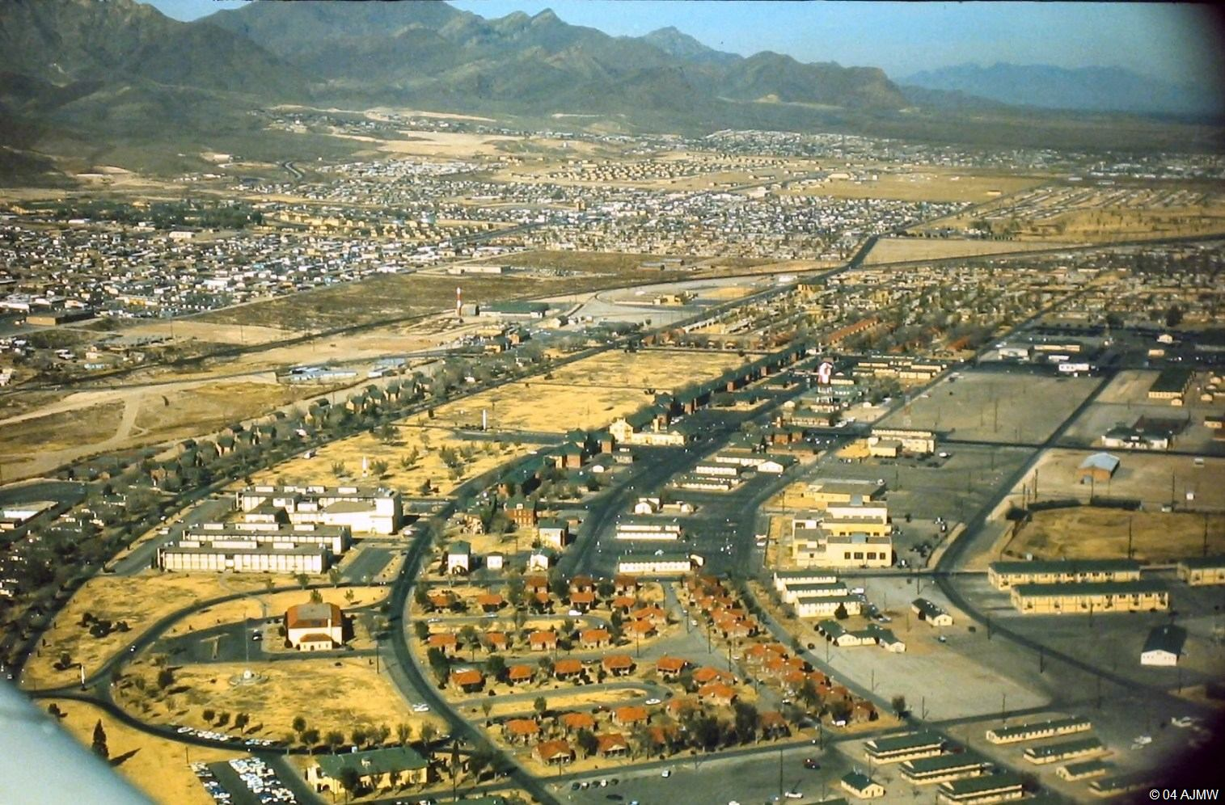
URBAN BLISS INDEX
Exploring Urban Happiness: Insights from the City Happiness Index
Unraveling the Factors that Shape City Well-being
Notes:
Why did we choose this topic?

Slide 3

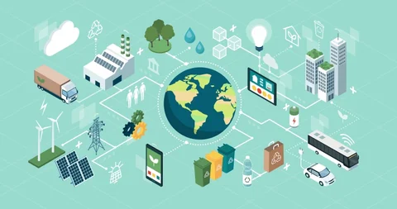
Table of Contents
Introduction
Overview of the Dataset
Background
Managerial Implication
Data Analysis
Conclusion

Slide 4
Introduction
Welcome to the presentation on the ‘Urban Bliss Index’
Which means City Happiness Index.
Curated by Emirhan BULUT, this dataset analyzes factors influencing overall happiness in global cities.
The dataset aims to provide insights into urban living conditions and populace satisfaction.
.

Slide 5
Overview of the Dataset
City Happiness Dataset
Examines global urban well-being
Factors: noise, traffic, green spaces, air, cost, healthcare
Influences overall happiness score
Applications
Researchers: Unravel urban dynamics
Policymakers: Enhance city life quality

Slide 6

Dataset's Key Characteristics
City Name, Month, and Year When Recorded
Noise Levels for Comfortable Hearing
Categories for Traffic Density
Amount of Green Space
Air Quality Rating
Level of Happiness
Cost of Living
Quality of Healthcare

Slide 7
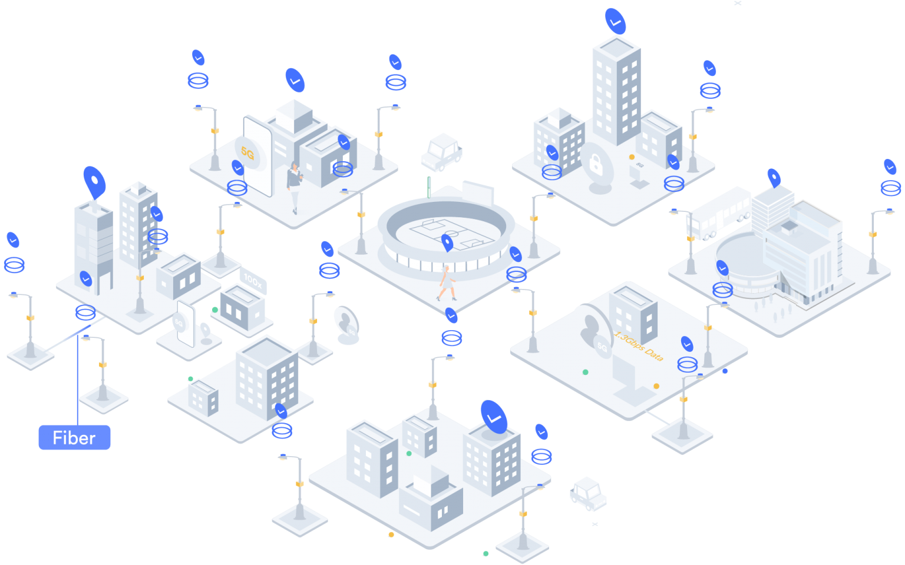
Objective of the study
Urban happiness crucial for quality of life in cities.
Insights help policymakers and researchers make informed decisions.
Understanding factors that shape happiness enhances urban well-being.

Slide 8
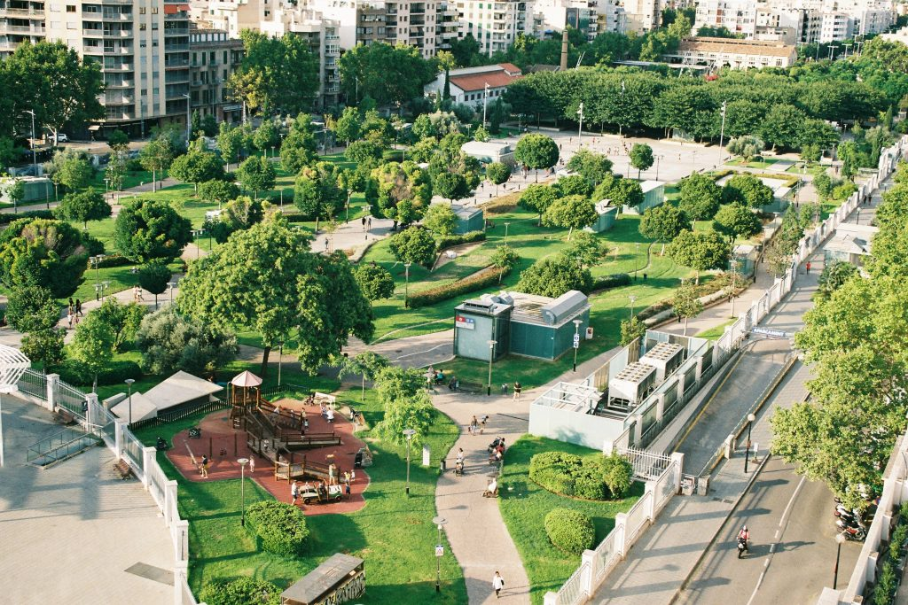
Business Problem
Predicting Well
Finding Good Data
Understanding Data
Getting People Involved
Being Fair and Respectful
Spending Money Wisely
Checking if it Works

Slide 9
Methodology
Data Collection
Key Factors Selection
Data Comparison
Information Integration
Accuracy Validation
Continuous Improvement
The City Happiness Index might have been created using software such as statistical tools like
Statistical Software: SPSS, R
Data Visualization Tools: Tableau, Power BI
Programming Languages: Python
Geographic Information System (GIS) Software: ArcGIS, QGIS
Machine Learning Frameworks: TensorFlow, PyTorch, scikit-learn
Spreadsheet Software: Microsoft Excel, Google Sheets

Slide 10
Managerial Implications
Urban Planning and Policy Decisions
Resource Allocation and Investment Strategies
Community Engagement and Participation
Infrastructure and Transportation Planning
Health and Well-being Initiatives
Economic Development and Tourism Promotion
Long-Term Sustainability Goals

Slide 11
Sample of the Data
The PIYAAI_2 Deep Q-Network Model
The "PIYAAI_2 Deep Q-Network Model" is a smart computer system.
It learns from experiences and tries to make good decisions.
It understands how happy cities are and predicts what might happen in the future, even if things change.
Notes:
PIYAAI_2 is an advanced Deep Q-Network model utilizing Reinforcement Learning, continuously improving its predictive abilities by learning from a specific dataset. This model holds potential for accurate predictions of future urban scenarios, adapting over time with new data to understand the factors influencing urban well-being and happiness.

Slide 12
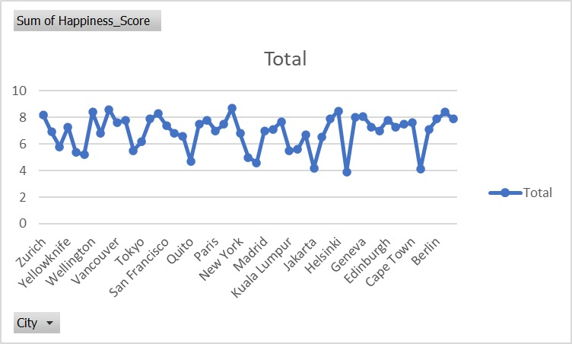
The Dataset
Visualization

Slide 13
Sources
https://data.gov/
https://www.gigasheet.com/sample-data/world-happiness-report-up-to-2023
https://worldhappiness.report/

Slide 14

Weekly Schedule of Project Progress
Week Start | Week End | Planned Progress
29-Jan | 4-Feb | Topic Research
5-Feb | 11-Feb | Topic Selection & Assignment of Tasks
12-Feb | 18-Feb | Research Methodology Selection & Project Proposal Creation
19-Feb | 25-Feb | Data Cleaning & Manipulation
26-Feb | 3-Mar | Data Cleaning & Pipeline Creation
4-Mar | 10-Mar | Data Modelling & Regression Analysis
11-Mar | 17-Mar | Data Visualisation & Inference
18-Mar | 24-Mar | Project Review and Auditing
25-Mar | 31-Mar | Research Report Writing
1-Apr | 7-Apr | Research Report Writing
8-Apr | 14-Apr | Final Review & Edit

Slide 15
Conclusion
The City Happiness Index provides a comprehensive analysis of urban well-being.
Crucial for understanding the interplay between urban factors and happiness.
A foundation for informed decision-making and policy formulation.

Slide 16
THANK YOU

